Slide 1
How can I find out about other research projects connected to my topic by using IRIS?
http://www.iris-database.org
Emma Marsden
Sophie Thompson

Slide 2
What is IRIS?
Repository of materials used to collect data for research
Free, open-access
Second language learning and teaching
Huge range of methods, approaches, research topics,
All materials have been used for peer-reviewed published research
1700 files -> 700 instruments for collecting data
9,500 downloads. 1/5 from teachers and teacher educators
Sustainable – long term funding

Slide 3
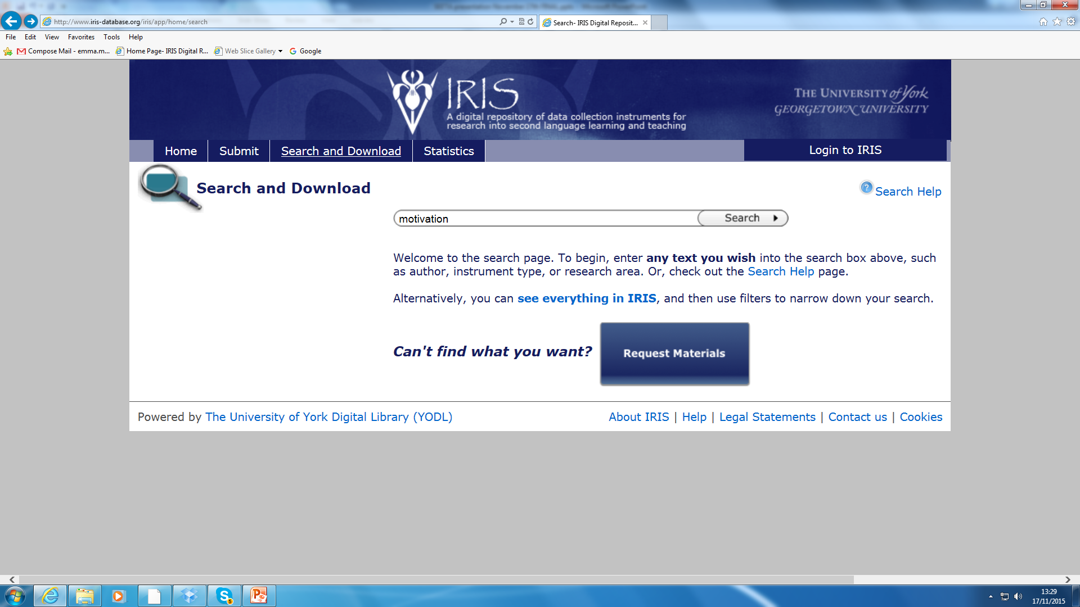

Slide 4
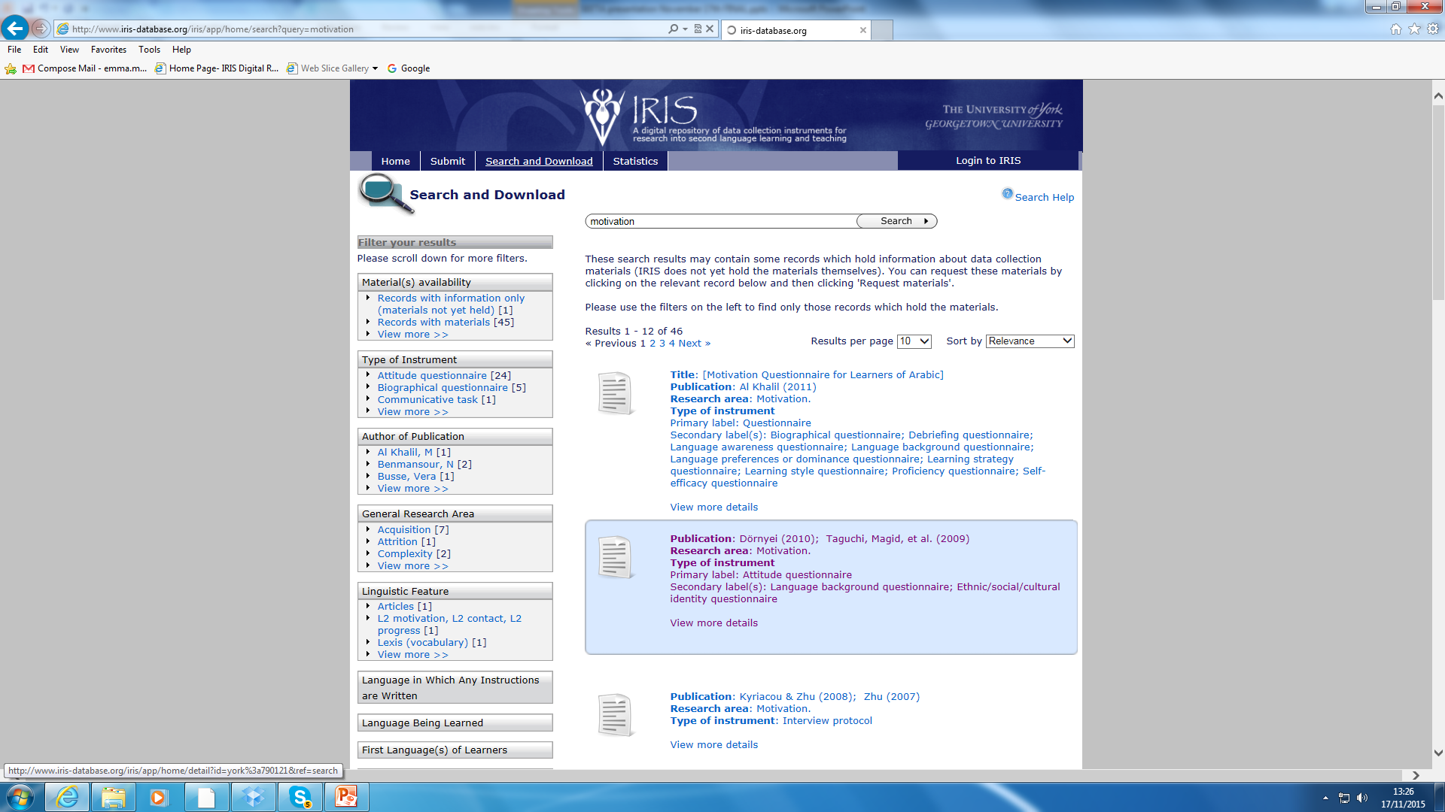

Slide 5
This webinar will outline areas of possible action research for the EFL classroom.
The research suggested will help you to answer some common questions that as teachers we have all asked.
The areas covered will be:
Student silence in class
Learner needs and motivation
Materials development
Classroom feedback
Five previous pieces of research, all accessible on IRIS will be outlined and some suggestions of how you might use the research in your own classes will be given.

Slide 6
1) Why are my students sometimes unwilling to communicate in class?
Cao, Y. & Philp, J. (2006). Interactional context and willingness to communicate: A comparison of behaviour in whole class, group and dyadic interaction. System,34(4), 480-493

Slide 7
Title / type of instrument(s): Interview/self-report questions and observation schedule
Aim of the study: to investigate students’ feelings about their willingness to communicate and determine which classroom activities promote student interaction.
Sample size: 10
Ages: 20-50
Proficiency: intermediate
Design: Willingness to communicate questionnaire on day one of the course, 2/week observations over 4 weeks, interview in the final week.
Findings:
learners behaved differently in different contexts
learners preferences varied across individuals
teachers should make use of varied interaction patterns in classes

Slide 8
How could you adapt this study?
use the questionnaires to regularly allow learners to assess their WTC and adapt classroom interaction accordingly (in particular the questions assessing classroom activities)
use the observation schedule to carry out CPD and to raise awareness of the value of different interaction types
run a full replica study using a bigger sample/different learners
use as a needs analysis for new students to determine their communication preferences
Issues
the WTC questionnaire will need adapting to match your learners experience
you could do this in the learners’ L1 with lower levels
8 observations is quite time-consuming so the observation scheme could be adapted to be a self-report scheme to raise teachers’ awareness

Slide 9
2) How do my learners feel about learning English?
Taylor, F. (2010) A quadripolar model of identity in adolescent foreign language learners.

Slide 10
Title / type of instrument(s): Student questionnaire (available in Spanish and English)
Aim of the study: to investigate how students identity varies in the classroom and how this affects
learning and attainment
Sample size: 1045
Ages: 14-19
Proficiency: intermediate +
Design: questionnaire given to students and took around 30 minutes to complete. Follow-up
interviews were carried out with volunteers (see appendix B in the article for guide)
Findings:
students appeared to have different “selves” or “fronts” at different times
most students believed the teacher could control their motivation
boys and girls differed greatly (boys had stronger “private-selves”
if teachers knew students better the classes would be more interesting

Slide 11
How could you adapt this study?
use as a start of term activity to get to know your students better
use the interview questions as a basis for a needs analysis/learner styles session in the first class - could encourage learners to come to the next class.
use collaboratively with students to determine their different “selves” - could be a mini project
investigate gender differences further
Issues
the wording will need adapting for adult learners
this was only carried out in Romania - gender differences might be less of an issue in other countries (worth exploring)
the causes of students responses were not fully investigated

Slide 12
3) Are the materials I use communicative enough?
· Barrot, J. (2012). Towards the development and validation of a sociocognitive-transformative materials design model for ESL learners.

Slide 13
Title / type of instrument(s): rating scale for materials assessment
Aim of the study: to create a model to help teachers assess the materials they use
Sample size: 10 experienced teachers - experience ranged from 15-45 years
Design: model was used to test materials designed to include cognitive, social, cultural,
and transformative components of learning (see for further information).
Findings: material appeared to be successfully evaluated using the scale and was rated as including the target components (above).

Slide 14
How could you adapt this study?
use the rating scale to evaluate your materials/your school’s materials
use the items on the scale to give you ideas when developing materials e.g. create “material (which) reflects social interaction and collaboration for language learning”.
use items from the scale as a focus for materials development sessions as part of CPD e.g. material promoting authentic language experience among learners.
Issues
very complex set of criteria - will need to be broken down for most of the above uses
not all criteria will be appropriate for your needs (be selective)
probably most useful as a guide rather than as a exhaustive set of criteria that must be met for all material

Slide 15
4) Why are my learners studying English?
What motivates them?
· You, C., & Dörnyei, Z. (in press). Language learning motivation in China: Results of a large-scale stratified survey. Applied Linguistics.

Slide 16
Title / type of instrument(s): motivation questionnaire
Aim of the study: to determine what motivates L2 learners of English (in China)
Sample size: 10,413
Age: 16 -19 (average age range)
Proficiency: various levels: upper-intermediate +
Design: questionnaires sent to learners and completed individually
Findings:
leaners were motivated by both the positive image learning English appears to have
and by the drive to do well outside school, e.g. in work or university.
results were in-line with findings from other countries and cultures

Slide 17
How could you adapt this study?
use as a needs analysis for your learners at the start of term - this could be repeated at different points to see if motivation changes
use as the basis for assessing motivation and then apply to setting goals for the learners to use throughout the year
carry out on a wider scale to assess learners in your country
Issues
the original was a huge study carried out only in China - would your country see different results
the study only looked at teens and young adults - what about older learners?
implications for teachers are not discussed much in the original - a smaller study with a focus on using the motivational knowledge gained in class planning would be beneficial

Slide 18
5) What kind of feedback should I give during tasks?
· Mackey, A., & Silver, R. E. (2005). Interactional tasks and English L2 learning by immigrant children in Singapore. System, 33 (2)

Slide 19
Title / type of instrument(s): communicative activity and feedback plan
Aim of the study: to find out if feedback during a tasks improves use of target language
Sample size: 26
Age: 6-9
Proficiency: pre-intermediate
Design: Various tasks focusing on question forms were given (one example above)
one group of children received on-going feedback and help during the tasks
whereas another group did not.
Findings: those who received feedback during the tasks improved production of correct question forms over the period of practice.

Slide 20
How could you adapt this study?
use the feedback plan to vary the type of teacher interaction in classes
use as the basis for observation of teachers to improve interactional feedback in class
adapt and use with other communicative tasks at other levels e.g. Cambridge certs. picture tasks and decision making tasks
Issues
only done with small children - how would it work with adults or more advanced learners
will work better with a range of communicative tasks - the one given is only an example e.g. meet-your-partner, picture ordering, story-board, information gap
type of feedback given will vary across different levels

Slide 21
Summary
Today we have:
Presented some ideas for how to carry out research in your classrooms
Made some suggestions for how past materials can be adapted for small-scale research
Provided some instruments that can be used or built on for CPD or for action research
Demonstrated how IRIS is a great resource for teachers to access for ideas and ready-made instruments for use in research or CPD.

Slide 22
The next stage is over to you!!
Please feel free to use the materials provided today or get on IRIS and start looking for other research ideas from the hundreds you can find there.
Thank you for taking the time to learn more about IRIS today.

